Slide 1
Phylum Porifera
BIO 2215
Oklahoma City Community College
Dennis Anderson

Slide 2
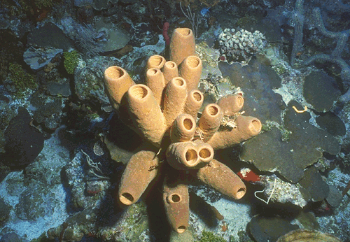
Phylum Porifera
Multicellular
Body with pores (ostia)
No organs or true tissues.
No nervous system
Adults sessile & attached to substratum.
Skeleton of calcareous spicules, siliceous spicules, spongin or a combination.
All aquatic, mostly marine.

Slide 3
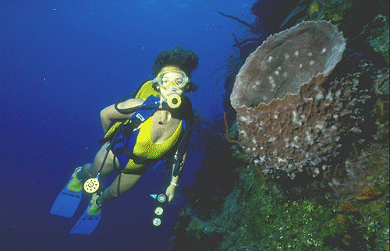
Phylum Porifera
Composed of 3 layers
  outer layer of flattened contractile cells (pinacocytes)
  inner non-living mesoglea containing a variety of specialized cells
  collar cells (choanocytes) which capture food, etc. from water flowing through channels.
Exhibit asymmetry or radial symmetry.
Reproduction - asexual by buds & gemmules. Sexual by eggs & sperm.

Slide 4
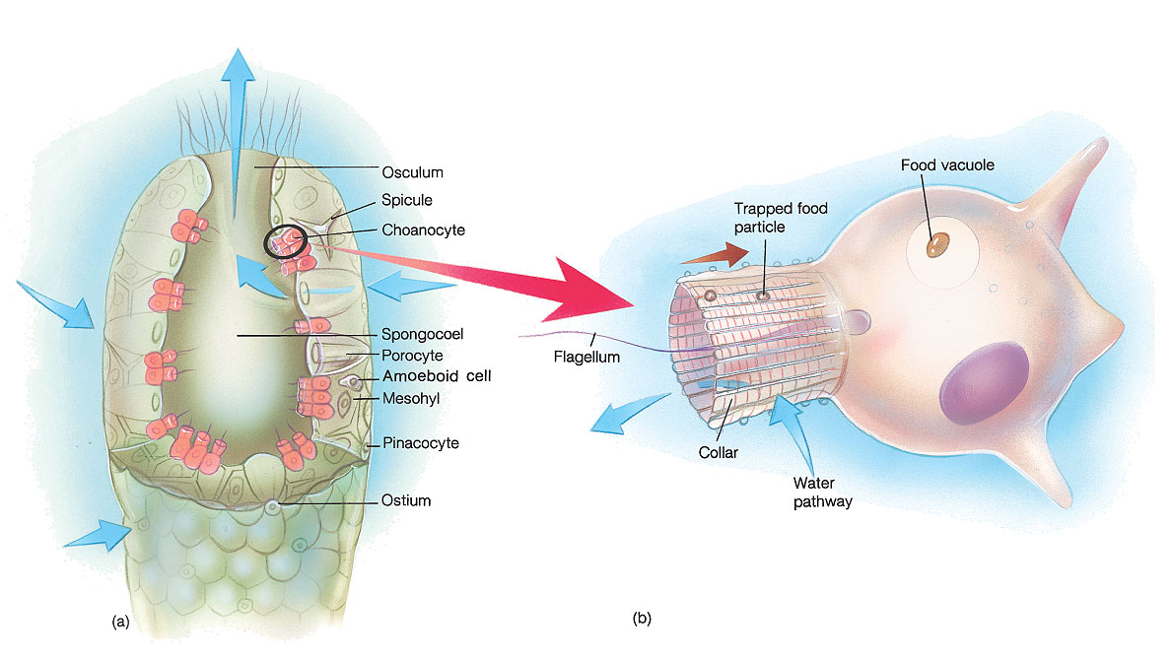
Copyright © The McGraw-Hill Companies, Inc. Permission required for reproduction or display.
Simple Sponge Morphology

Slide 5
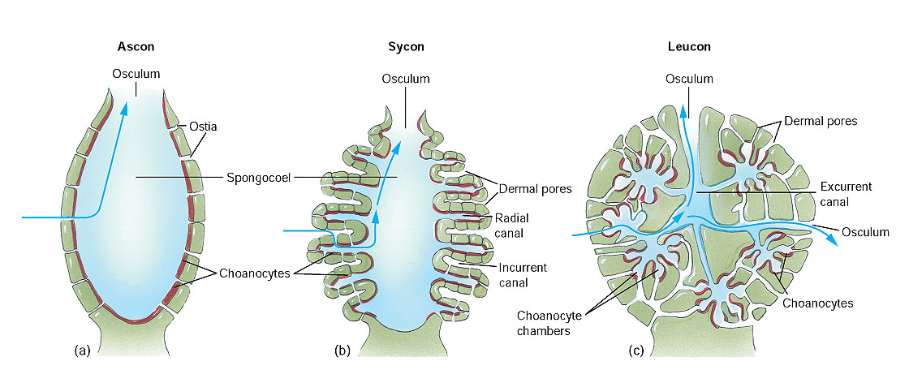
Copyright © The McGraw-Hill Companies, Inc. Permission required for reproduction or display.
Sponge Body Forms

Slide 6
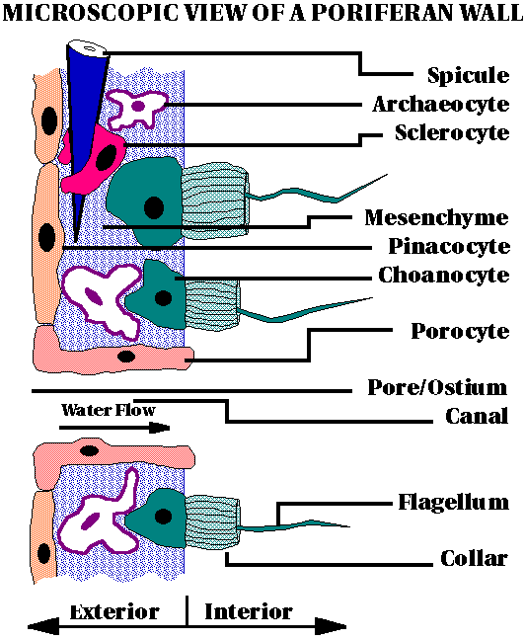

Slide 7
Spicule
Skeleton of sponge
  Calcium carbonate
  Silicon
  Collagen

Slide 8
Archeocyte
Amoeboid cells
Receive food from choanocytes
Differentiate into other cell types

Slide 9
Sclerocyte
Produce spicules

Slide 10
Mesenchyme
(Mesoglea or Mesohyl)
Gelantinous matrix

Slide 11
Pinococyte
Outer surface of sponge
Contractile

Slide 12
Choanocyte
Flagellated cells
One end in mesnchyme
Flagella creates water currents
Collar traps food
Passes food to archeocyte

Slide 13
Porocyte
Forms a pore

Slide 14
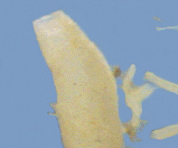
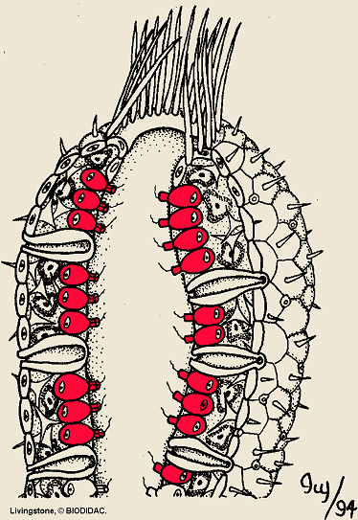
Asconoid Sponge
Osculum
Spongocoel
Ostium
Porocyte

Slide 15
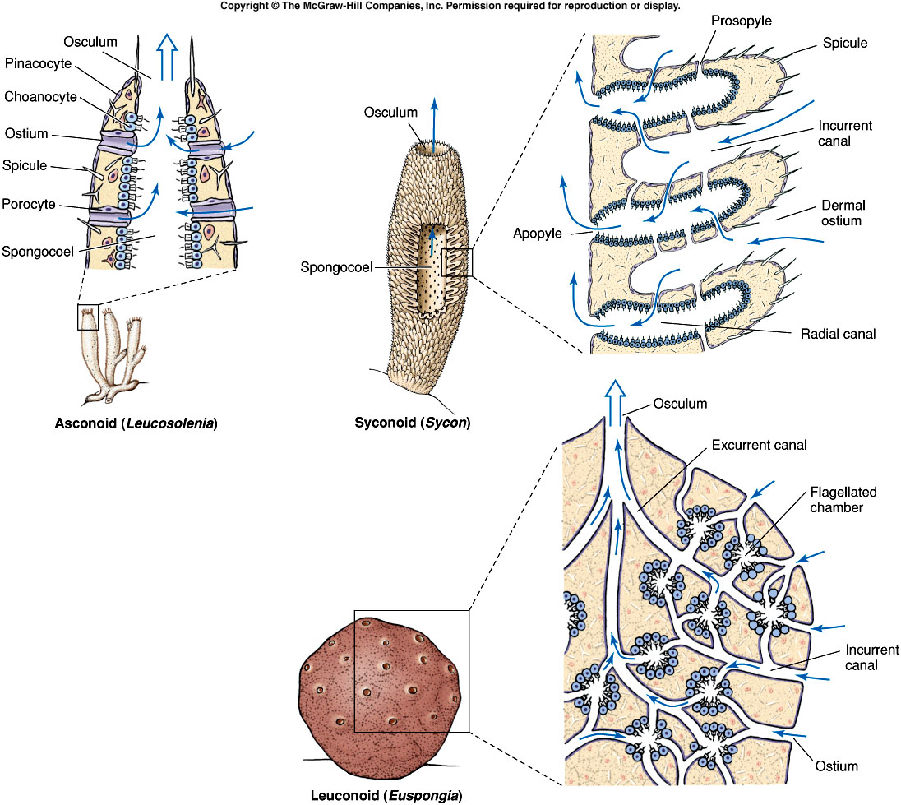
Fig. 12.5
Notes:
Fig. 12.5

Slide 16
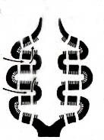
Syconoid Sponge
Osculum
Spongocoel
Incurrent Canal
Radial Canal
Ostium
Choanocytes

Slide 17
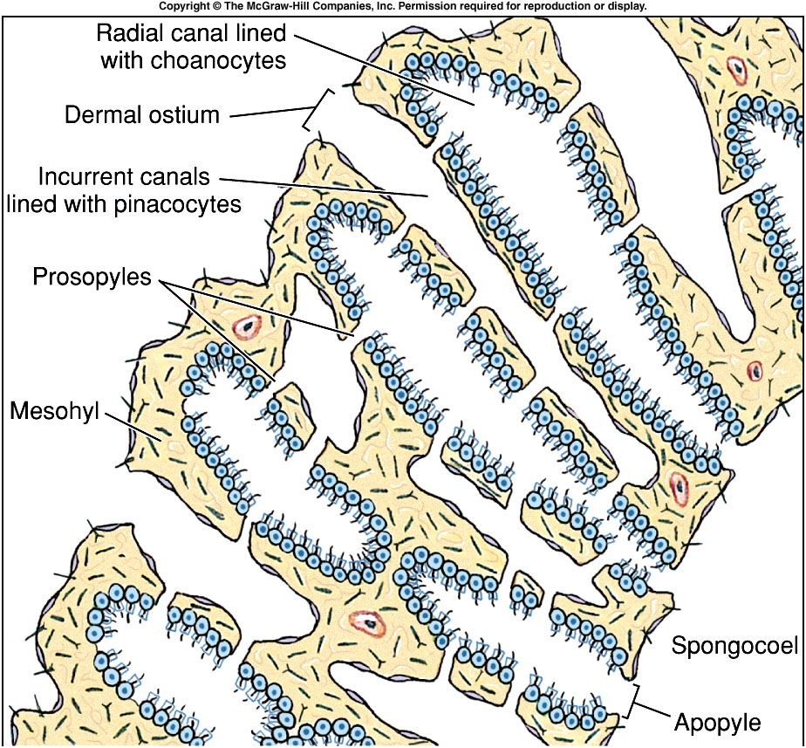
Fig. 12.7
Notes:
Fig. 12.7

Slide 18
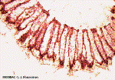
Syconoid Sponge
Scypha (Grantia) xs
Spongocoel
Radial Canal
Incurrent Canal
Choanocytes
Ostium

Slide 19
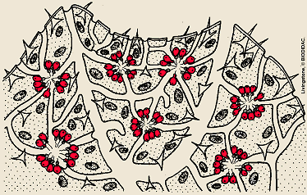
Leuconoid Sponge
Osculum
Excurrent canal
Incurrent pore
Incurrent canal
Choanocyte
chamber

Slide 20
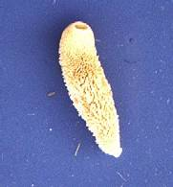
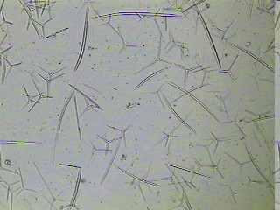
Class Calcarea
Grantia
Small
Vase shape
Spicules of calcium carbonate
  Straight or 3-4 rays

Slide 21
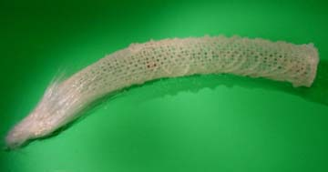
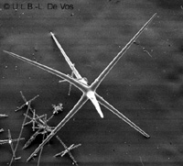
Class Hexactinellida
Euplectella
Spicules
  Siliceous
  6 rays

Slide 22
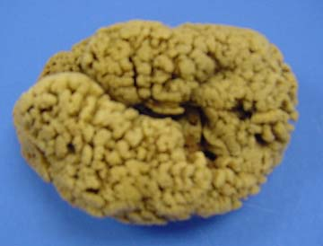
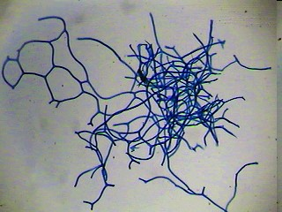
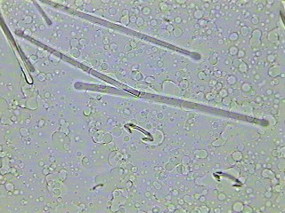
Class Demospongiae
Spongia
Spicules
  Siliceous
  spongin

Slide 23
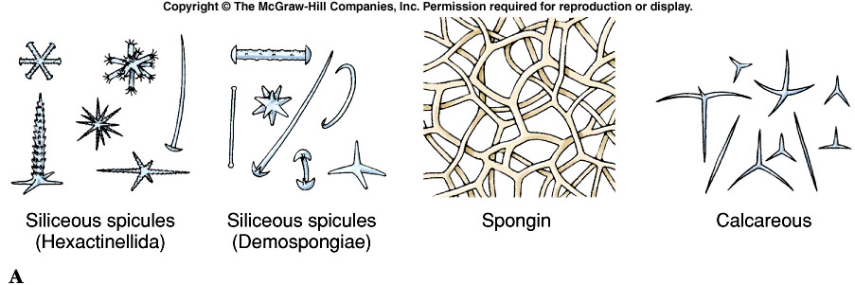
Notes:
Fig. 12.11a

Slide 24
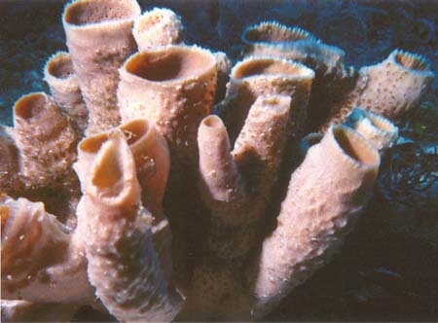
Physiology
Large sponges filter 1500 liters/day
Choanocytes phagocytize
Archeocytes digest
No respiratory, excretory or nervous systems

Slide 25
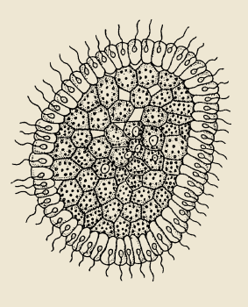
Sexual Reproduction
Monoecious
  Both male and female
Sperm and egg derived from choanocytes
Ciliated larva
  Swim to new location

Slide 26
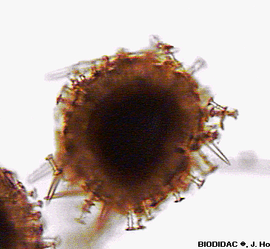
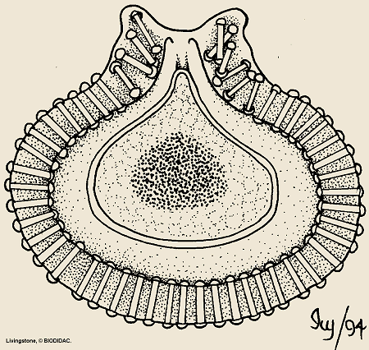
Asexual Reproduction
Micropyle
Budding
Fragmentation
Gemmule formation
-survive freezing
Spicule

Slide 27
Porifera
Platyhelmithes
Mollusca
Arthropoda
Echinodermata
Hemichordata
Cnidaria
Nemertea
Annelida
Lophophores
Chordata
Precambrian
Before 670 MYA
Protozoans

Slide 28
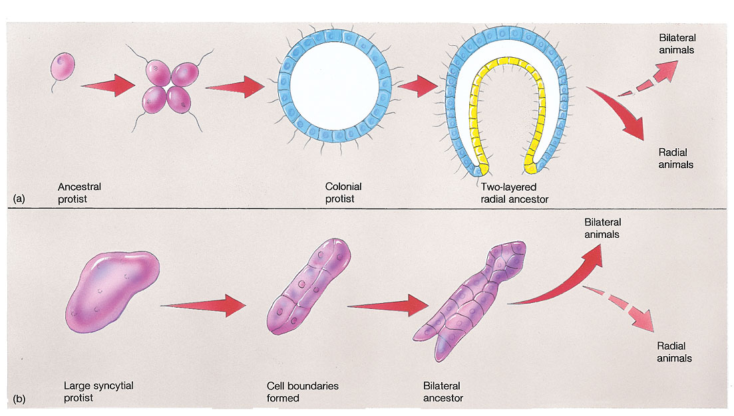
Copyright © The McGraw-Hill Companies, Inc. Permission required for reproduction or display.
Hypothesis of Multicellularity

Slide 29
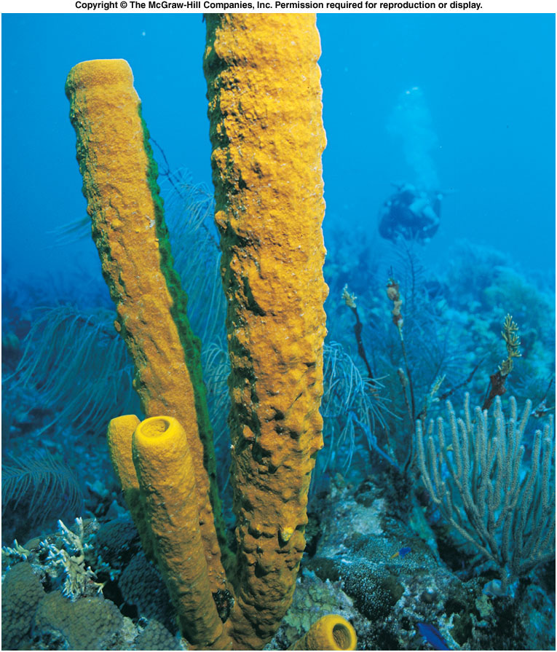
CO 12
The End
Notes:
Fig. 12.CO

